Slide 1
Red-Black Trees
Presented By: Sushma Balikai

Slide 2
Contents:
Abstract
Introduction
Rules
Why Red-Black trees
Insertion in Red-Black tree
Pseudo code for insertion in Red-Black tree
Example
Deletion in Red-Black tree
Pseudo code for deletion in Red-Black tree
Examples
Applications
Advantages & Disadvantages

Slide 3
Abstract:
Data structure is a way of defining, storing and retrieving of data in a structural and systematic way.
There are 2 types of Data structures are there:
Linear Data structures- Arrays,Linkedlist,Stack,Queue
Non-linear Data structures-Trees and Graphs
Tree: Tree is a Non-linear data structure consisting of one node called root and zero or one or more subtrees.

Slide 4
Introduction:
Red-Black Tree is invented in 1972 by Rudolf Bayer.
It is a self balancing binary search tree.
In this each node stores an extra bit representing color (“Red” or “Black”).
Although balance of tree is not perfect, it is good enough to reduce the searching time.
Each node requires only 1 bit of space to store the color information, these type of trees show identical memory footprint to classic(uncolored) binary search tree.

Slide 5
Rules:
Every node has a color either “Red” or “Black”.
The root of the tree is always black.
There are no two adjacent red nodes (means red parent cannot contain red child).
Every path from a root node to any of its null nodes must have the same number of black nodes.
All null nodes are considered Black nodes.

Slide 6
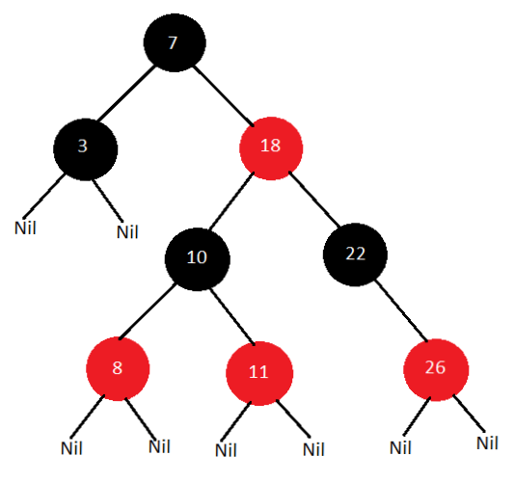
Example of Red-Black tree
1.Root of the tree is Black in color.
2.There are no two adjecent Red
nodes.
3.Every path from Root node to any
of its null node has same number
of Black nodes.

Slide 7
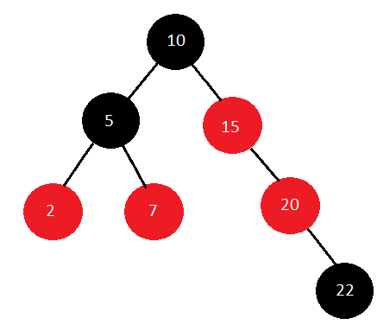
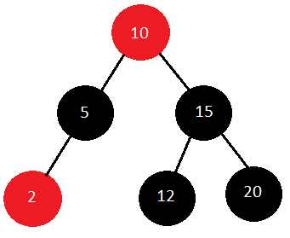
Examples which are not Red-Black trees
Root node is Red
Red parent contains a red child

Slide 8
Why Red-Black Trees?
They are self balancing binary search trees.
It has less rotations than AVL trees.
Red-Black trees are good at frequent insertion and deletion than lookup(search).

Slide 9
Insertion in Red-Black tree:
If tree is empty, create new node as root node with color black.
If tree is not empty, create new node as leaf node with color red.
If parent of new node is black then exit.
If parent of new node is red, then check the color of parents siblings of new node
A. If color is black or null then do the suitable rotation and recolor.
Case 1- (i) Parent sibling is black
a) Node is left child of right child then right rotate
around parent
b) Node is right child of left child then left rotate around
parent

Slide 10
(ii) Parent become the new node to check violation
Case 2- (i) Parent sibling is black
a) Node is right child of right child then left rotate
around ground parent
b) Node is left child of left child then right rotate
around ground parent
(ii) Change color of parent & ground parent
(iii) ground parent become new node
B. If color is red then recolor & also check if parents parent of new node is not root node then recolor it & recheck.

Slide 11
Pseudo code for Insertion in Red-Black tree:
RB-INSERT (T, z)
y ← nil [T]
x ← root [T]
while x ≠ NIL [T]
do y ← x
if key [z] < key [x]
then x ← left [x]
else x ← right [x]
p [z] ← y

Slide 12
Continue….
if y = nil [T]
then root [T] ← z
else if key [z] < key [y]
then left [y] ← z
else right [y] ← z
left [z] ← nil [T]
right [z] ← nil [T]
color [z] ← RED
RB-INSERT-FIXUP (T, z)

Slide 13
Inserting the value z=4
11
2
14
y ← Nil(T)
15
1
7
5
8
Nil(T)
y

Slide 14
Inserting the value z=4
x, y
11
14
x ← root[T]
while x ≠ Nil[T] (True)
do y ← x
if key[z] < key[x]
4 < 11(True)
then x ← left[x]
2
15
1
7
5
8
Nil(T)

Slide 15
Inserting the value z=4
11
2
14
x, y
while x ≠ Nil[T] (True)
do y ← x
if key[z] < key[x]
4 < 2 (False)
else x ← right[x]
15
1
7
5
8
Nil(T)

Slide 16
Inserting the value z=4
11
2
14
while x ≠ Nil[T] (True)
do y ← x
if key[z] < key[x]
4 < 7 (True)
then x ← left[x]
x, y
15
1
7
5
8
Nil(T)

Slide 17
Inserting the value z=4
11
2
14
while x ≠ Nil[T] (False)
do y ← x
if key[z] < key[x]
then x ← left[x]
15
1
7
x
5
8
Nil(T)

Slide 18
Inserting the value z=4
11
2
14
while x ≠ Nil[T] (False)
do y ← x
if key[z] < key[x]
then x ← left[x]
else x ← right[x]
P[z] ← y
This is not Executed
1
7
15
x, y
5
8
z
4
Nil(T)

Slide 19
Inserting the value z=4
11
2
14
P[z] ← y
if y = Nil[T] (False)
then root[T] ← z
else if key[z] < key[y]
4 < 5 (True)
then left[y] ← z
else right[y] ← z
left[z] ← Nil[T]
right [z]← Nil[T]
color[z] ← RED
1
7
15
x, y
5
8
z
4
Nil(T)

Slide 20
Pseudo code for RB-INSERT-FIXUP:
RB-INSERT-FIXUP (T, z)
while color [p[z]] = RED
do if p [z] = left [p[p[z]]]
then y ← right [p[p[z]]]
if color [y] = RED
then color [p[z]] ← BLACK //Case 1
color [y] ← BLACK //Case 1
color [p[p[z]]] ← RED //Case 1
z ← p[p[z]] //Case 1
else if z= right [p[z]]
then z ← p [z] //Case 2

Slide 21
Continue….
LEFT-ROTATE (T, z) //Case 2
color [p[z]] ← BLACK //Case 3
color [p [p[z]]] ← RED //Case 3
RIGHT-ROTATE (T, p [p[z]]) //Case 3
else (same as then clause)
With "right" and "left" exchanged
color [root[T]] ← BLACK

Slide 22
RB INSERT FIXUP
11
2
14
P[P[z]]
while color[P[z]]=Red
do if p [z] = left [p[p[z]]]
1
7
15
P[z]
5
8
z
4

Slide 23
RB INSERT FIXUP
11
2
14
then y ← right [p[p[z]]]
if color [y] = RED (True)
P[P[z]]
1
7
15
P[z]
y
5
8
z
4

Slide 24
RB INSERT FIXUP
11
2
14
then color [p[z]] ← BLACK //Case 1
color [y] ← BLACK //Case 1
color [p[p[z]]] ← RED //Case 1
P[P[z]]
1
7
15
P[z]
y
5
8
z
4

Slide 25
RB INSERT FIXUP
11
2
14
z
1
7
15
z ← p[p[z]] //Case 1
y
5
8
4

Slide 26
RB INSERT FIXUP
P[P[z]]
11
P[z]
y
while color[P[z]]=Red
do if p [z] = left [p[p[z]]] (True)
then y ← right [p[p[z]]]
if color [y] = RED (False)
then color [p[z]] ← BLACK //Case 1
color [y] ← BLACK //Case 1
color [p[p[z]]] ← RED //Case 1
z ← p[p[z]] //Case 1
2
14
z
1
7
15
5
8
4

Slide 27
RB INSERT FIXUP
11
Left Rotation
z
y
if color [y] = RED (False)
then color [p[z]] ← BLACK //Case 1
color [y] ← BLACK //Case 1
color [p[p[z]]] ← RED //Case 1
z ← p[p[z]] //Case 1
else if z= right [p[z]] (True)
then z ← p [z] //Case 2
LEFT-ROTATE (T, z) //Case 2
2
14
1
7
15
5
8
4

Slide 28
RB INSERT FIXUP
11
z
y
7
14
LEFT-ROTATE (T, z) //Case 2
2
8
15
1
5
4

Slide 29
RB INSERT FIXUP
Right Rotation
11
y
7
14
color [p[z]] ← BLACK //Case 3
color [p [p[z]]] ← RED //Case 3
RIGHT-ROTATE (T, p [p[z]]) //Case 3
z
2
8
15
1
5
4

Slide 30
RB INSERT FIXUP
7
RIGHT-ROTATE (T, p [p[z]]) //Case 3
else (same as then clause)
With "right" and "left" exchanged
color [root[T]] ← BLACK
2
11
1
5
8
14
4
15

Slide 31
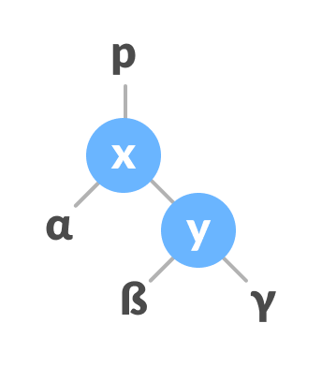
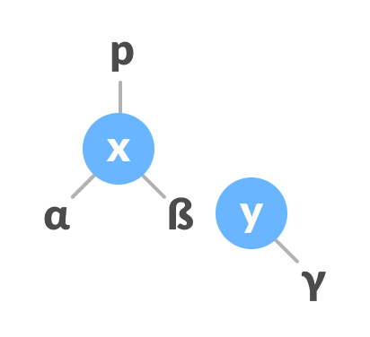
Left Rotation:
In left-rotation, the arrangement of the nodes on the right is transformed into the arrangements on the left node.
Algorithm:
1. Let the initial tree be
2. If y has a left subtree, assign x as the parent of the left subtree of y.
Assign x as the parent of the left subtree of y

Slide 32
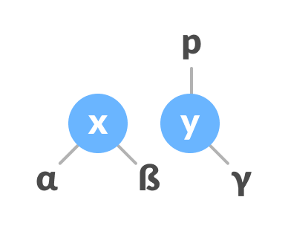
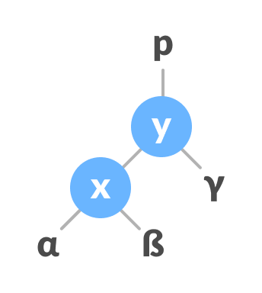
3. If the parent of x is NULL, make y as the root of the tree.
4. Else if x is the left child of p, make y as the left child of p.
5. Else assign y as the right child of p
6. Make y as the parent of x.
Change the parent of x to that of y
Assign y as the parent of x.

Slide 33
Pseudo code for LEFT Rotation:
LEFT ROTATE(T, x)
y ← right [x]
right [x] ← left [y]
p [left[y]] ← x
p[y] ← p[x]
If p[x] = nil [T]
then root [T] ← y
else if x = left [p[x]]
then left [p[x]] ← y
else right [p[x]] ← y
left [y] ← x.
p [x] ← y.

Slide 34
LEFT ROTATION
Left Rotation
x
y
Left Rotation(T, x)
α
γ
y
x
β
γ
α
β

Slide 35
Example for Left Rotation
7
x
4
11
y
LEFT ROTATE(T, x)
y ← right [x]
9
18
14
19
22
12
17
20

Slide 36
Example for Left Rotation Continue
7
y
right [x] ← left [y]
p [left[y]] ← x
p[y] ← p[x]
if p[x] = nil [T] (False)
then root [T] ← y
else if x = left [p[x]] (False)
then left [p[x]] ← y
else right [p[x]] ← y (True)
left [y] ← x.
p [x] ← y.
4
18
x
11
19
22
9
14
20
17
20

Slide 37
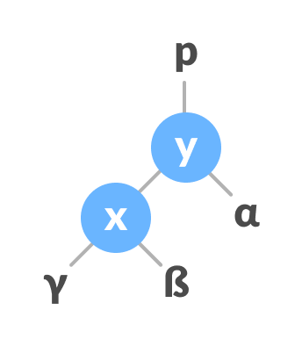
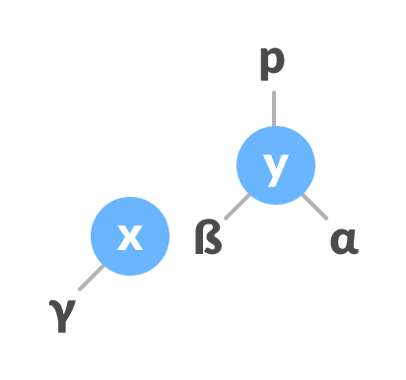
Right Rotation:
In right-rotation, the arrangement of the nodes on the left is transformed into the arrangements on the right node.
Algorithm:
1. Let the initial tree be
Initial Tree
2. If x has a right subtree, assign y as the parent of the right subtree of x
Assign y as the parent of the right subtree of x

Slide 38
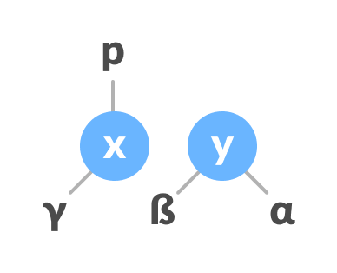
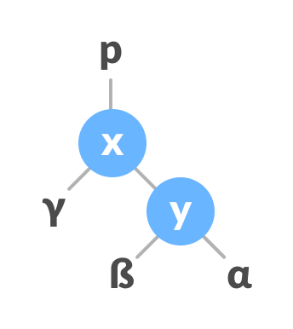
3. If the parent of y is NULL, make x as the root of the tree.
4. Else if y is the right child of its parent p, make x as the right
child of p.
5. Else assign x as the left child of p.
Assign the parent of y as the parent of x
6. Make x as the parent of y.
Assign x as the parent of y

Slide 39
RIGHT ROTATION
Right Rotation
y
x
Right Rotation
α
γ
y
x
β
γ
α
β

Slide 40
Example for Right Rotation
Right Rotation
10
5
5
12
Right Rotation
2
10
2
8
8
12
6
9
6
9

Slide 41
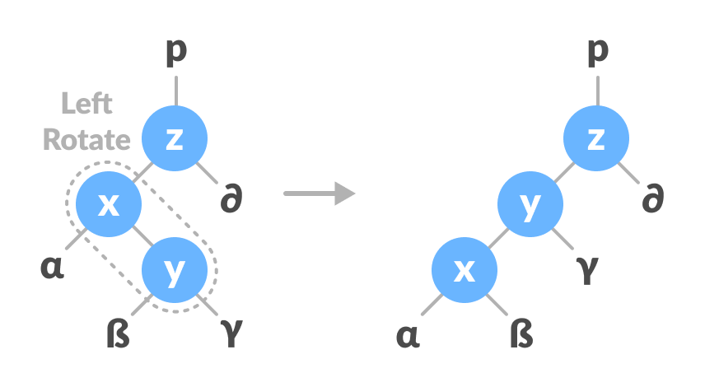
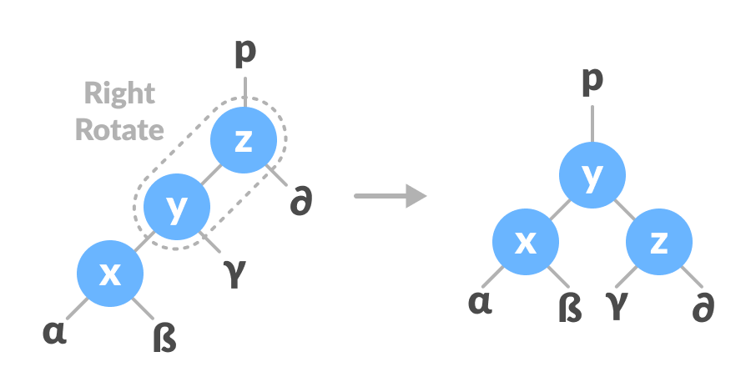
Left-Right Rotate:
In left-right rotation, the arrangements are first shifted to the left and then to the right.
1. Do left rotation on x-y
2. Do right rotation on y-z
Left rotate x-y
Right rotate z-y

Slide 42
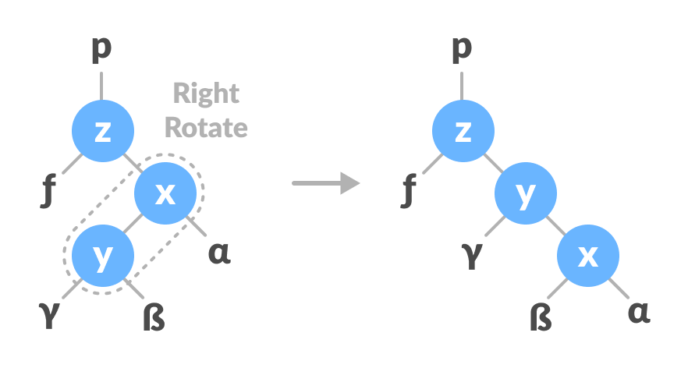
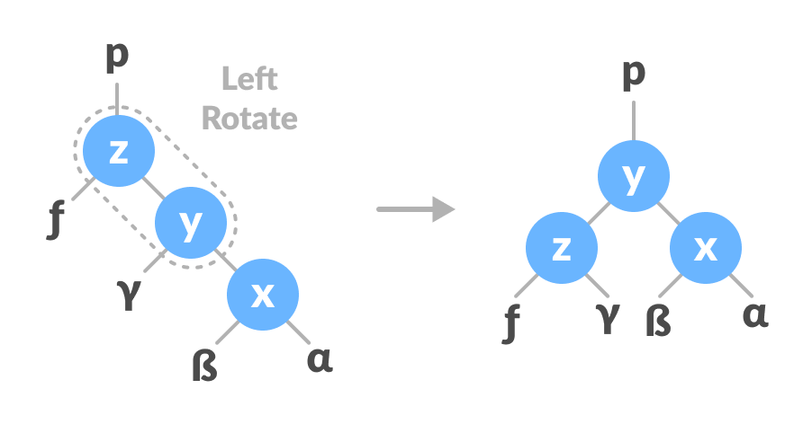
Right-Left Rotation:
In right-left rotation, the arrangements are first shifted to the right and then to the left.
1. Do right rotation on x-y.
2. Do left rotation on z-y.
Right rotate x-y
Left rotate z-y

Slide 43
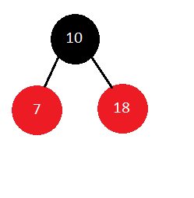

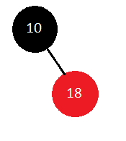
Example: 10 18 7 15 16 30 25
Insert 10
Insert 18
Insert 7
Element 10 is inserted as a root node with Black color
Element 18 is inserted as a leaf node with Red color
Element 7 is inserted as a leaf node with Red in color

Slide 44
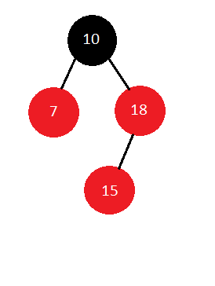
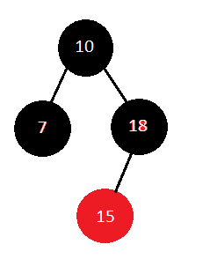
Insert 15
Element 15 is inserted as a leaf node to 18 with Red color
As Red parent contains Red child both parent and parent sibling color changes to Black

Slide 45
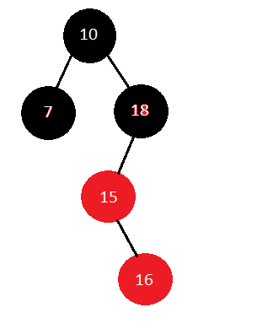
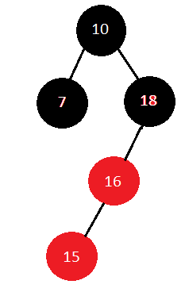
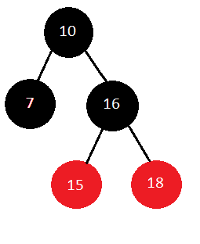
Insert 16:
Element 16 is inserted as a leaf node to 15 with Red color
As Red parent contains Red child Left Rotation will takes place
After Left Rotation Right Rotation will takes place

Slide 46
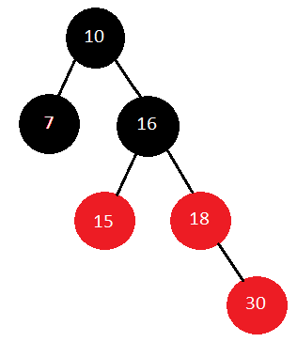
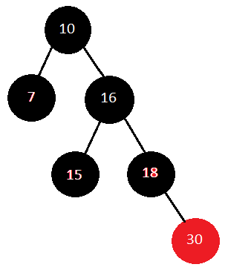
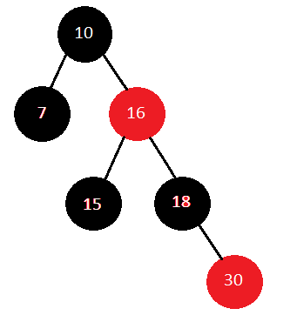
Insert 30
As Red parent contains Red child color of parent and parent sibling color changes to Black
And it rechecks parents parent is not root node so it is also changes to Black to Red color
Element 30 is inserted as a leaf node to 18

Slide 47
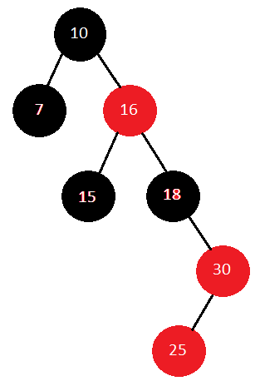
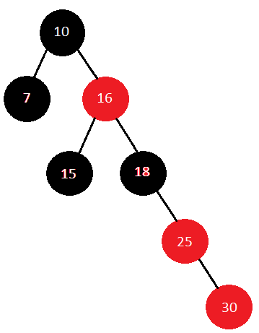
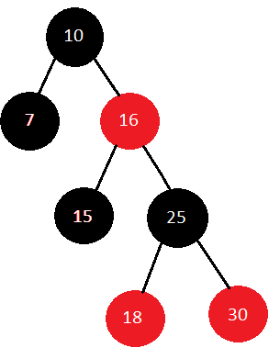
Insert 25:
Element 25 is inserted as a leaf node to 30
As Red parent contains Red child first Right Rotation will takes place
After Right Rotation Left Rotation will takes place

Slide 48
Deletion in Red-Black Trees:
Step 1: Perform BST deletion.
Step 2: Case1 - If node to be deleted is red, just delete it.
Case2 - If root is double black(DB), just remove DB.
Case3 - If DB’s sibling is black, & both its children
are black
-> Remove DB
-> Add black to its parent(P)
-> If P is Red it becomes black
-> If P is black it becomes double black
-> Make sibling red
If still DB exist apply other cases

Slide 49
Continue….
Case4 - If DB’s sibling is Red
-> Swap colors of parent & its sibling
-> Rotate parent in DB direction
-> Reapply cases
Case5 - DB’s sibling is black, sibling’s child who is far
from DB is black, but near child to DB is Red
-> Swap color of DB’s sibling & siblings child
who is near to DB
-> Rotate sibling in opposite direction to DB
-> Apply cases

Slide 50
Continue….
Case6 - DB’s sibling is black, far child is red
-> Swap color of parent & sibling
-> Rotate parent in DB’s direction
-> Remove DB
-> Change color of red child to black

Slide 51
Pseudo code for Deletion in Red-Black tree:
RB-DELETE (T, z)
if left [z] = nil [T] or right [z] = nil [T]
then y ← z
else y ← TREE-SUCCESSOR (z)
if left [y] ≠ nil [T]
then x ← left [y]
else x ← right [y]
p [x] ← p [y]

Slide 52
Continue….
if p[y] = nil [T]
then root [T] ← x
else if y = left [p[y]]
then left [p[y]] ← x
else right [p[y]] ← x
if y≠ z
then key [z] ← key [y]
copy y's satellite data into z
if color [y] = BLACK
then RB-delete-FIXUP (T, x) return y

Slide 53
Example for deletion in Red-Black Tree
41
30
47
28
38
nil
nil
nil
nil
35
39
nil
nil
nil
nil

Slide 54
Deleting 39 (i.e. z=39)
41
30
47
if left [z] = nil [T] or right [z] = nil [T]
(True)
28
38
z
35
39
nil(T)

Slide 55
Deleting 39 (i.e. z=39)
41
30
47
if left [z] = nil [T] or right [z] = nil [T]
then y ← z
else y ← TREE-SUCCESSOR (z)
28
38
z, y
35
39
nil(T)

Slide 56
Deleting 39 (i.e. z=39)
41
30
47
if left [y] ≠ nil [T] (False)
then x ← left [y]
else x ← right [y]
28
38
z, y
35
39
nil(T)
x

Slide 57
Deleting 39 (i.e. z=39)
41
30
47
p [x] ← p [y]
28
38
z, y
35
39
nil(T)
x

Slide 58
Deleting 39 (i.e. z=39)
41
30
47
nil is right or left child to 38
if p[y] = nil [T] (False)
then root [T] ← x
else if y = left [p[y]] (False)
then left [p[y]] ← x
else right [p[y]] ← x
28
38
z, y
35
39
nil(T)
x

Slide 59
Deleting 39 (i.e. z=39)
41
30
47
if y≠ z (False)
then key [z] ← key [y]
copy y's satellite data into z
if color [y] = BLACK (False)
then RB-delete-FIXUP (T, x)
return y
28
38
z, y
35
39
nil(T)
x

Slide 60
After deleting 39 resulting tree will be
41
30
47
z
28
38
35
nil(T)

Slide 61
Deleting 38 (i.e. z=38)
41
30
47
if left [z] = nil [T] or right [z] = nil [T]
then y ← z
else y ← TREE-SUCCESSOR (z)
z, y
28
38
35
nil(T)

Slide 62
Deleting 38 (i.e. z=38)
41
30
47
if left [y] ≠ nil [T] (True)
then x ← left [y]
else x ← right [y]
z, y
28
38
x
35
nil(T)

Slide 63
Deleting 38 (i.e. z=38)
41
30
47
z, y
p [x] ← p [y]
28
38
x
35
nil(T)

Slide 64
Deleting 38 (i.e. z=38)
41
To decide whether x is left or right child to 30
if p[y] = nil [T] (False)
then root [T] ← x
else if y = left [p[y]] (False)
then left [p[y]] ← x
else right [p[y]] ← x
30
47
z, y
28
38
x
35
nil(T)

Slide 65
After deleting 38 the resulting tree will be
41
30
47
if y≠ z (False)
then key [z] ← key [y]
copy y's satellite data into z
if color [y] = BLACK (True)
then RB-delete-FIXUP (T, x)
return y
z, y
28
35
nil(T)

Slide 66
Deleting 30 (i.e. z=30)
41
z
30
47
28
38
35
nil(T)

Slide 67
Deleting 30 (i.e. z=30)
41
z
30
47
if left [z] = nil [T] or right [z] = nil [T]
(False)
then y ← z
else y ← TREE-SUCCESSOR (z)
28
38
y
35
nil(T)

Slide 68
Deleting 30 (i.e. z=30)
41
z
30
47
if left [y] ≠ nil [T] (False)
then x ← left [y]
else x ← right [y]
28
38
y
35
nil(T)
x

Slide 69
Deleting 30 (i.e. z=30)
41
z
30
47
p [x] ← p [y]
28
38
y
35
nil(T)
x

Slide 70
Deleting 30 (i.e. z=30)
41
Deciding whether x is connected to left or right of 38
if p[y] = nil [T] (False)
then root [T] ← x
else if y = left [p[y]] (True)
then left [p[y]] ← x
else right [p[y]] ← x
z
30
47
28
38
y
35
nil(T)
x

Slide 71
Deleting 30 (i.e. z=30)
41
z
35
47
if y≠ z (True)
then key [z] ← key [y]
copy y's satellite data into z
if color [y] = BLACK (False)
then RB-delete-FIXUP (T, x)
return y
28
38
y
35
nil(T)
x

Slide 72
After deleting 30 the resulting tree will be
41
35
47
28
38
nil(T)

Slide 73
Pseudo code for RB-DELETE-FIXUP:
RB-DELETE-FIXUP (T, x)
while x ≠ root [T] and color [x] = BLACK
do if x = left [p[x]]
then w ← right [p[x]]
if color [w] = RED
then color [w] ← BLACK //Case 1
color [p[x]] ← RED //Case 1
LEFT-ROTATE (T, p [x]) //Case 1
w ← right [p[x]] //Case 1
if color [left [w]] = BLACK and color [right[w]] = BLACK
then color [w] ← RED //Case 2
x ← p[x] //Case 2

Slide 74
Continue…
else if color [right [w]] = BLACK
then color [left[w]] ← BLACK //Case 3
color [w] ← RED //Case 3
RIGHT-ROTATE (T, w) //Case 3
w ← right [p[x]] //Case 3
color [w] ← color [p[x]] //Case 4
color p[x] ← BLACK //Case 4
color [right [w]] ← BLACK //Case 4
LEFT-ROTATE (T, p [x]) //Case 4
x ← root [T] //Case 4
else (same as then clause with "right" and "left" exchanged)
color [x] ← BLACK

Slide 75
Example: 55, 30, 90, 80, 50, 35, 15
50
30
65
55
70
15
35
68
80
90

Slide 76
Delete 55
50
We cannot delete 55 directly because it is black so it is replace with nil
Then check sibling of DB it is Red apply Case 4.
30
65
DB
15
35
n
70
68
80
90

Slide 77
Delete 55
50
30
65
Parent and sibling color changed
Parent rotate in DB direction
DB
15
35
n
70
68
80
90

Slide 78
Delete 55
50
30
70
Again Reapply cases
Check sibling of DB it is Black and both childrens are Black apply Case 3
15
35
65
80
DB
90
n
68
Still DB exist

Slide 79
After deleting 55 the Tree will be
50
30
70
15
35
65
80
90
68

Slide 80
Delete 30
50
50
30
70
35
70
DB
80
15
65
80
15
35
65
n
90
68
90
68
30 is having 2 childrens we cannot delete it directly we replace it with in order successor
To remove DB check its siblings it is Black childs also Black apply Case 3

Slide 81
Delete 30
DB
50
50
DB
35
70
35
70
80
15
65
80
15
n
65
90
68
90
68
Check sibling of 35 it is Black and childs also Black apply Case3
Now Root is DB simply remove the DB

Slide 82
After Deleting 30 the resulting Tree will be
50
35
70
15
65
80
68
90

Slide 83
After deleting 90 the resulting Tree
will be
Delete 90
50
50
35
70
35
70
80
15
65
80
15
65
68
90
68
Node we deleting is Red then simply delete it

Slide 84
Delete 80
50
50
35
70
35
70
DB
15
65
80
15
65
n
68
68
We cannot delete 80 directly because it is Black replace it with nil
Check sibling of DB it is Black and it has one child that is near to DB having Red color so apply Case 5

Slide 85
Delete 80
50
50
35
70
35
70
DB
DB
15
65
n
15
68
n
Sibling and its child color changed
68
65
Still DB exist
Check sibling of DB it is Black & far child to DB having Red apply Case 6
Sibling rotate opposite to DB

Slide 86
Delete 80
50
50
35
70
35
68
DB
15
68
n
15
65
70
DB
65
n
Parent rotate in DB direction
Remove DB and change color of Red child

Slide 87
After deleting 80 resulting Tree will be
50
35
68
15
65
70

Slide 88
Delete 50
50
65
35
68
35
68
DB
15
65
70
15
n
70
50 is having 2 childs we will replace it with in order successor
Check sibling of DB it is Black and its childs are also Black then apply Case 3

Slide 89
After deleting 50 the resulting Tree will be
65
35
68
15
70

Slide 90
Delete 35
65
65
35
68
15
68
15
70
70
35 is having one child with Red color so simply replace it with its child and 35 is deleted

Slide 91
Delete 15
65
65
DB
15
68
n
68
70
70
15 is Black we cannot delete it directly
Sibling of DB is Black and far child having Red color we change color of parent and sibling

Slide 92
Delete 15
65
68
DB
68
65
70
n
DB
70
n
Rotate parent in DB direction
Remove DB & change color of red child to black

Slide 93
After deleting 15 the resulting Tree will be
68
65
70

Slide 94
Applications:
It is used to implement CPU scheduling Linux.
MYSQL also uses the Red-Black tree for indexes on tables.
Most of the self-balancing BST library functions like map & set in C++ (or treeset & treemap in java) use Red-Black tree.

Slide 95
Advantages & Disadvantages:
Advantages:
Red-Black tree balance the height of the binary tree.
Red-Black tree takes less time to structure the tree.
Disadvantages:
It is a binary tree & thus lookups are O(log n) where as hash tables have a lookup of O(1).

Slide 96
THANK YOU

Slide 97
ANY QUERIES?

